Slide 1

Kickstarter Oracle
Kickstarting your kickstarter campaign

Slide 2
Content
Meet the team.
Understand the market.
Meet Kickstarter-Oracle
Commercial viability.
Technological overview.

Slide 3
The Team

Slide 4
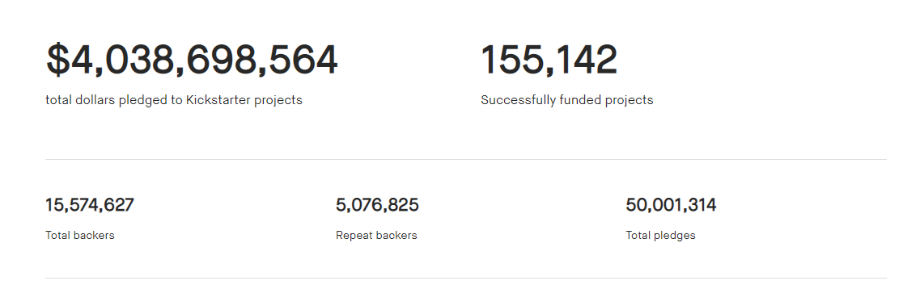
Understand the market
Current funding success rate ~36%

Slide 5
Kickstarter oracle Mission statement
Kickstarter-oracle (KO) shall provide it’s customers with highly beneficial insights for improving their funding campaign. leveraging AI technology and past campaign information KO shall play a fundamental role in it’s customers funding success..
Our success criteria : KO customers funding success rate >72%.

Slide 6
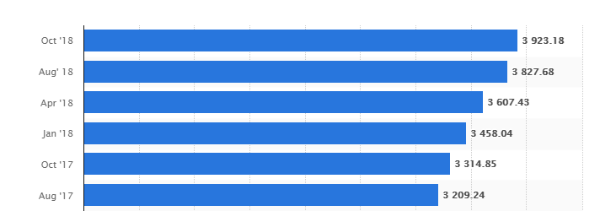
Kickstarter oracle – commercial viability
KO shall charge it’s customers a 0.1% commission of money pledged (for successful campaign).
Based on a 10% initial adoption rate KO expected monthly income ~$400K (based on Oct 2018 funding statistics)
Funds pledged for kickstarted projects ($M)

Slide 7
Data handling
Initial data: approx. 500K lines, 45 columns
Data preparation activities:
Phrasing of a category column.
Split date columns into single columns per day/month/ year
Turn success/fail data into numerical
Drop missing creator lines

Slide 8
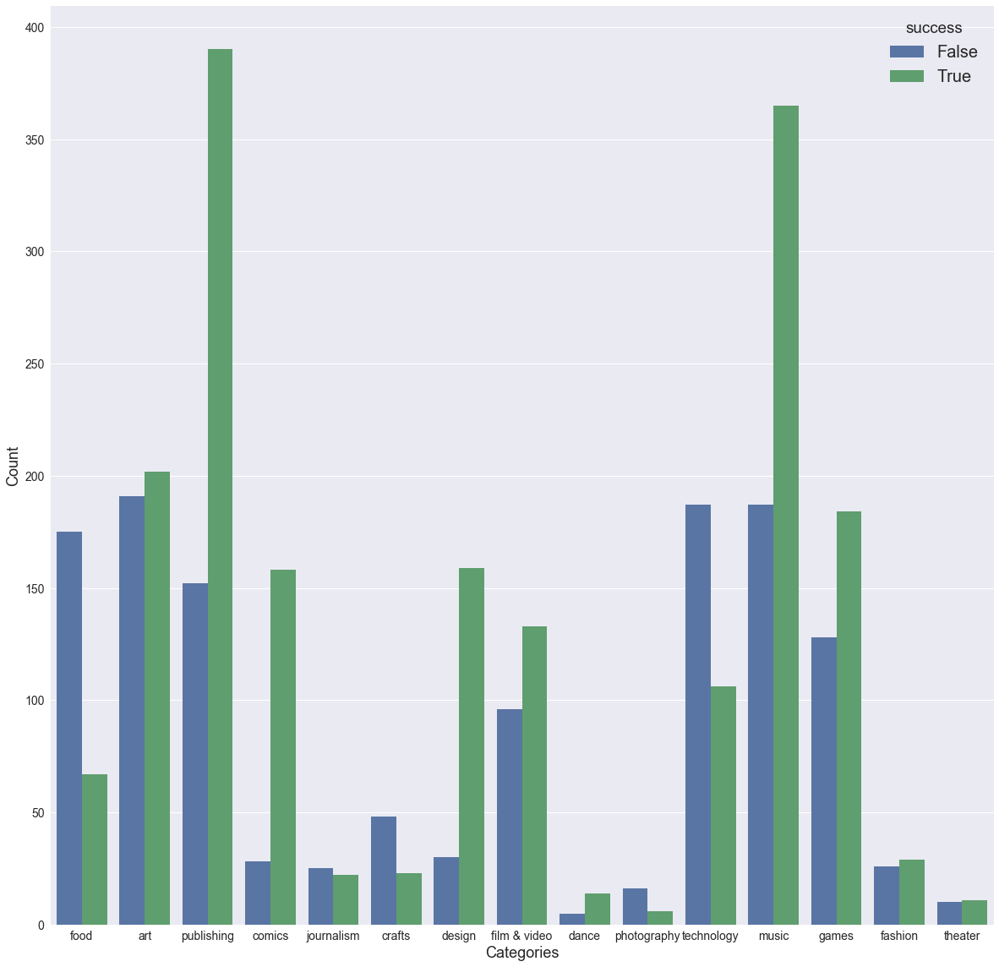
Initial observations
Clear bias towards publishing and music projects.
High correlation factors between success and:
Category 0.32
Staff pick 0.26

Slide 9
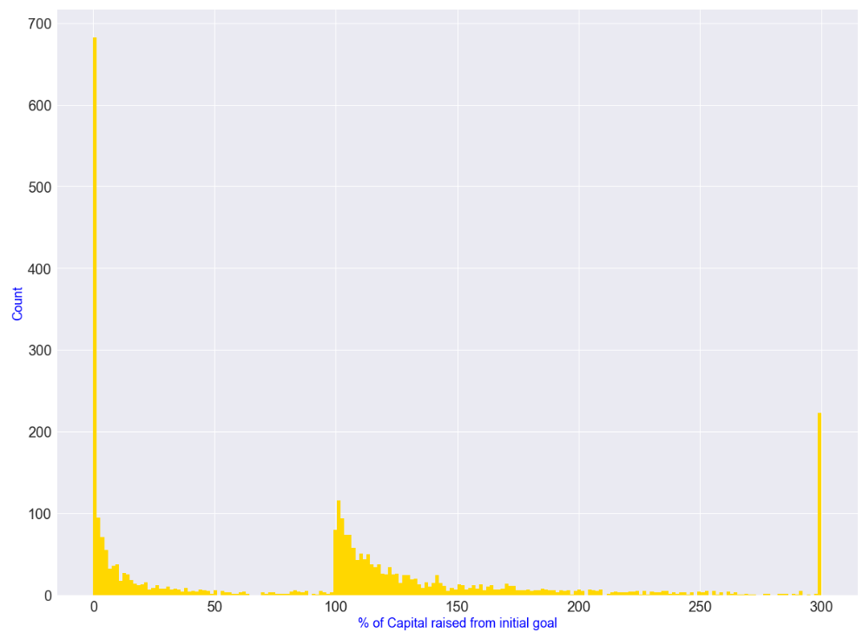
Initial observations- Continued
Most failures are attributed to lack of interest and not a funding failure
Successes distribute exponentially from target (i.e. target could have been set higher?)
Need to understand outliers

Slide 10


Slide 11

Digital Communications
Cloud
Local
Hybrid

Slide 12

Thank You
someone@example.com

